Slide 1



Hello, DevTools Reshape the Web

Slide 2
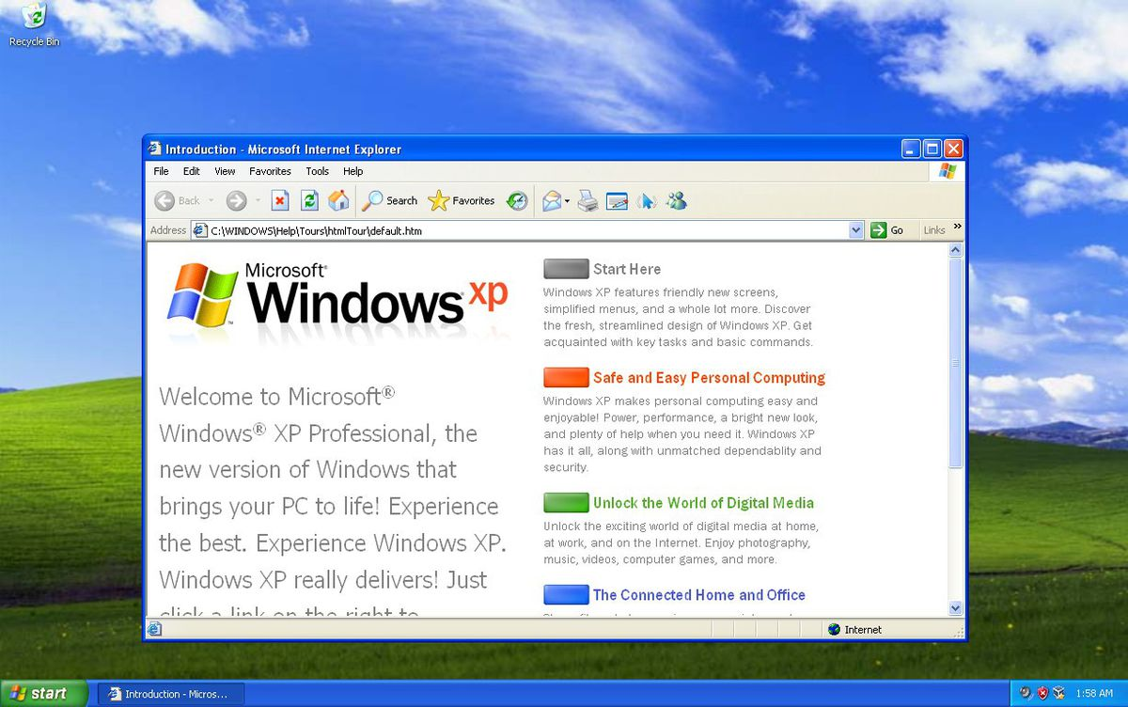
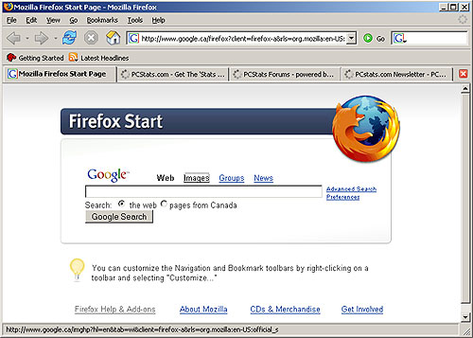
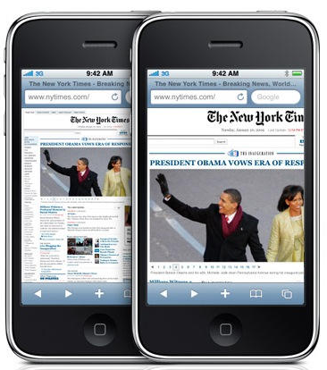
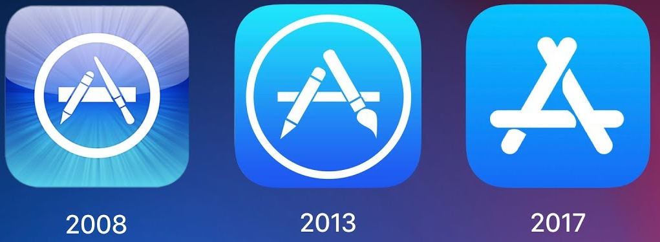
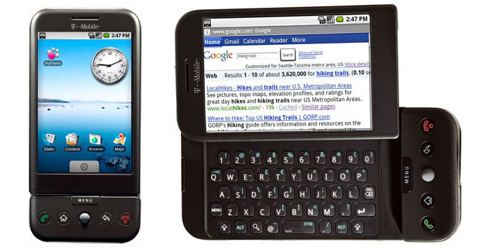
Back in my day…
Windows XP: 2001
Mozilla Firefox: 2004
iPhone: 2007
Android 1.0: 2008
iOS App Store: 2008

Slide 3

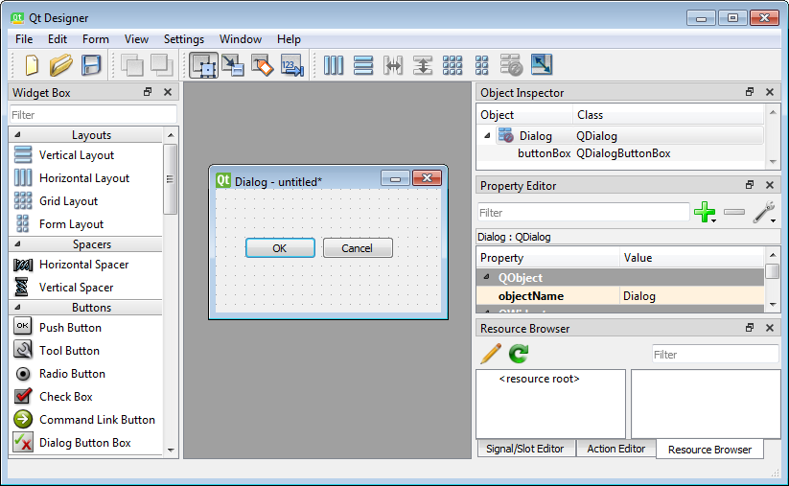





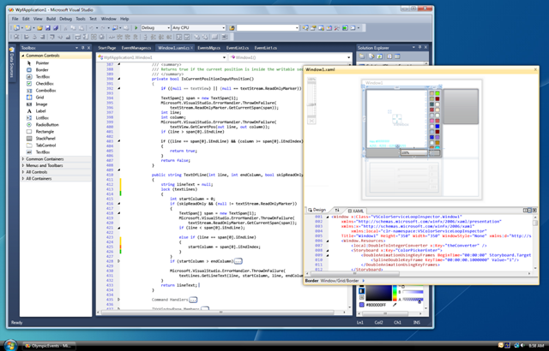
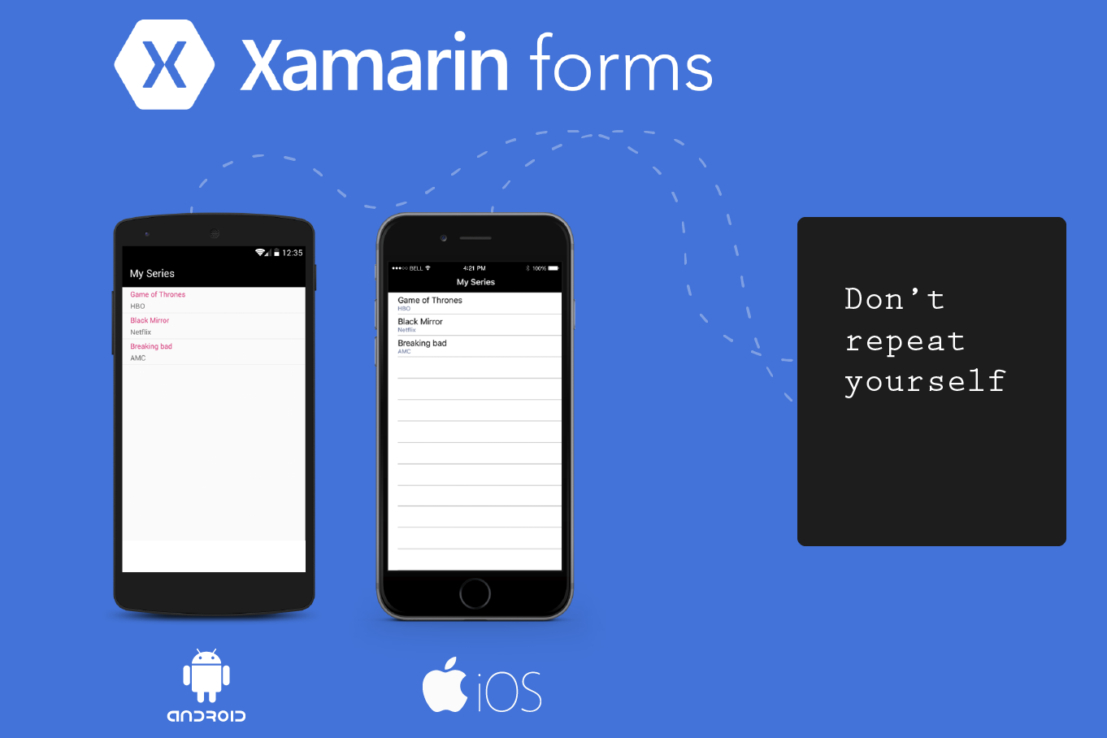


Big Idea: Write Once, Use "Everywhere"
Want: "native-like" experiences everywhere
Don't Want: paying for a dedicated developer for every platform
Java on Android, 2008
Qt C++ for iOS, Android, 2011
Visual Studio C#, VB .NET 4.0, 2009
Xamarin C#, Android, Mac, 2012

Slide 4



HTTP Network Model Ask and ye shall receive
GET google.com
200 OK
GET google.com/lsjkdf
404 Not Found
Observe: HTTP is courteous and polite
HTTP is stateless, every request is independent

Slide 5
What comes down the pipe?
200 OK
HTML
"Hyper-Text Markup Language"
Static text content and descriptive markup
CSS
"Cascading Style Sheets" Static appearance, positioning, styling, animation (new!)
JavaScript
Dynamic content, actual programming, webpage manipulation,
Network requests
Media
Images, video, downloads, files

Slide 6
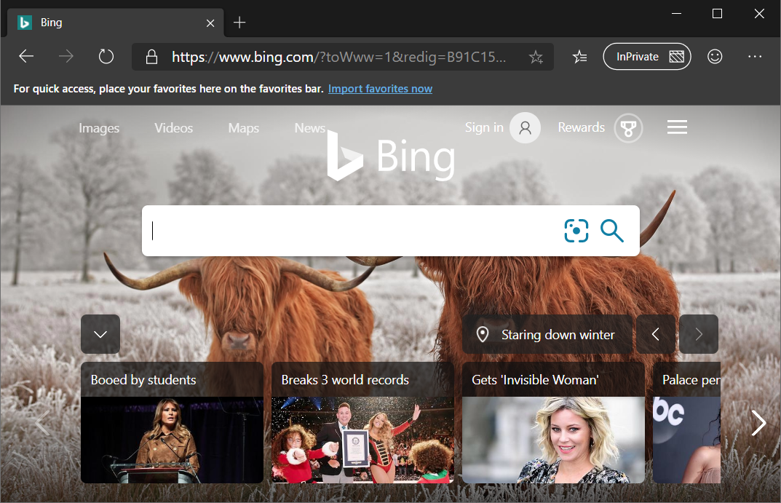
What comes down the pipe?
HTML
"Hyper-Text Markup Language"
Static text content and descriptive markup
CSS
"Cascading Style Sheets" Static appearance, positioning, styling, animation (new!)
JavaScript
Dynamic content, actual programming, webpage manipulation,
Network requests
Media
Images, video, downloads, files

Slide 7
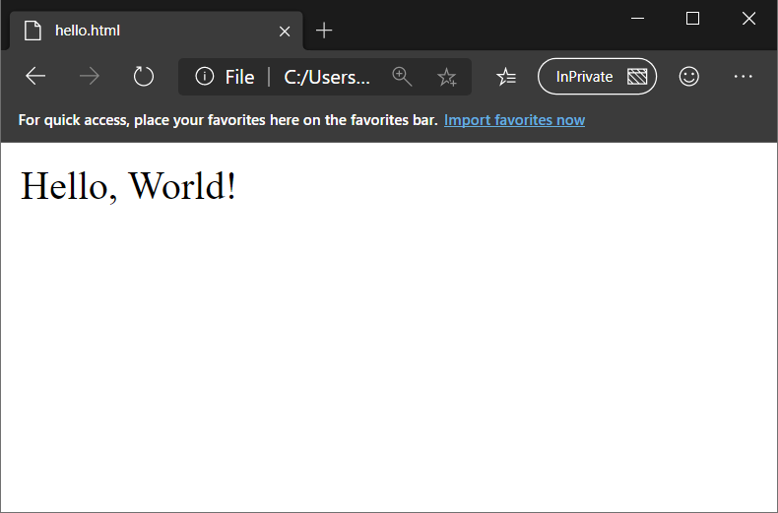
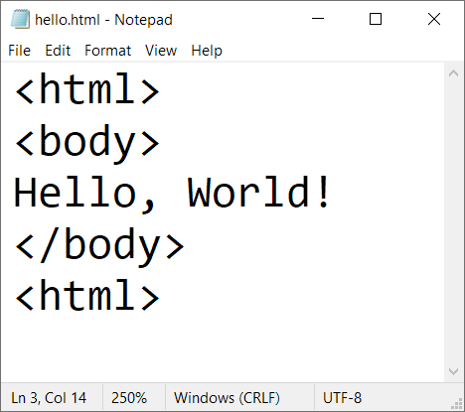

Slide 8
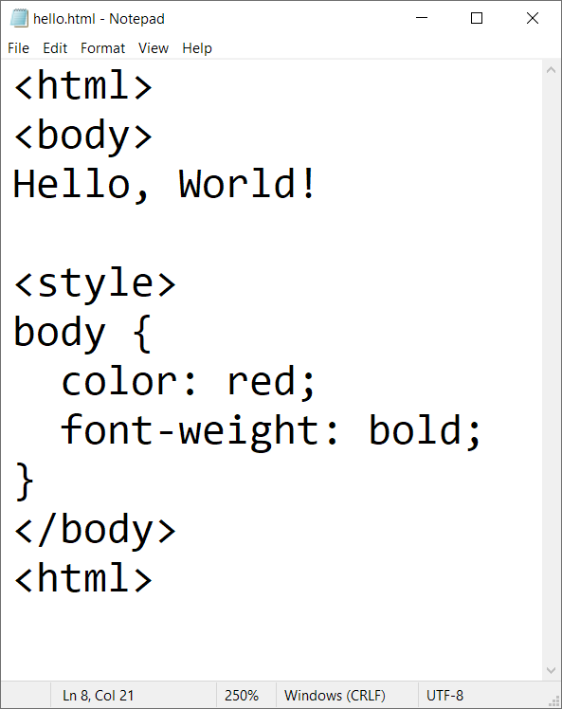
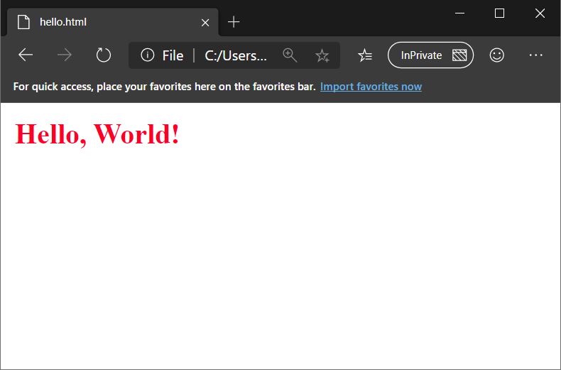

Slide 9
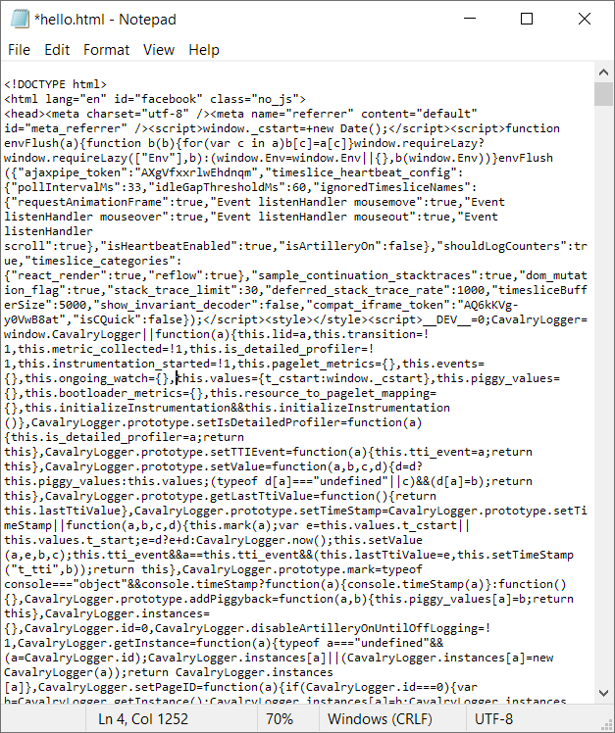
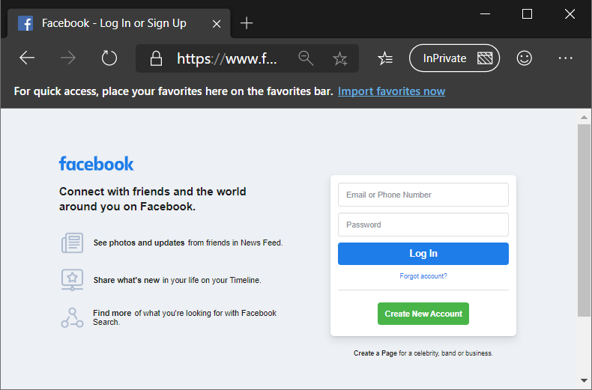
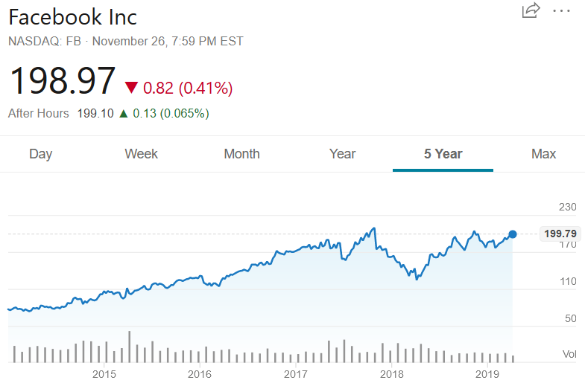

Slide 10
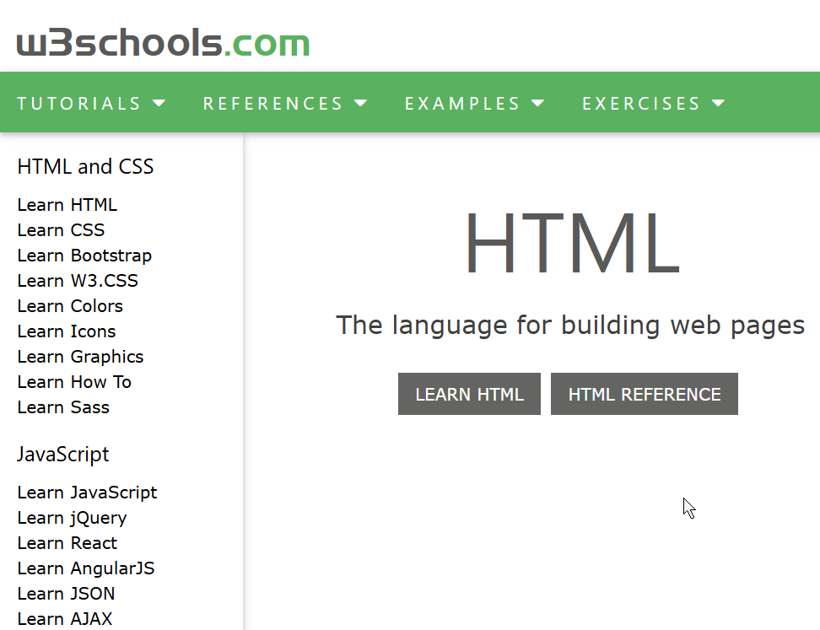
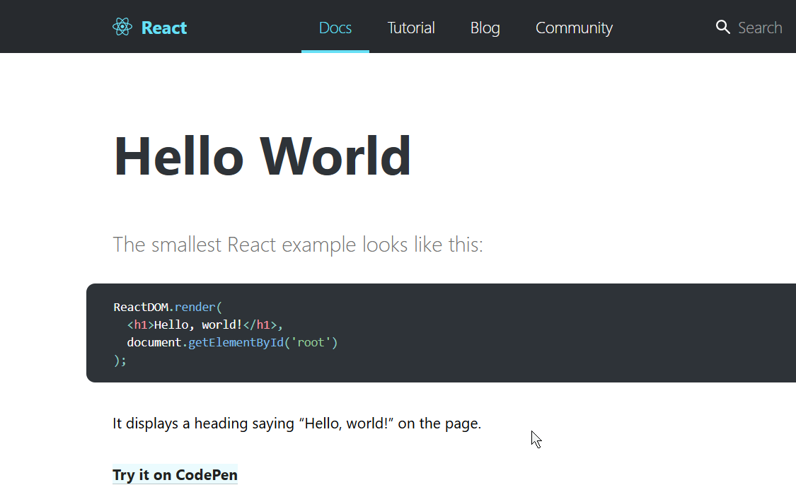
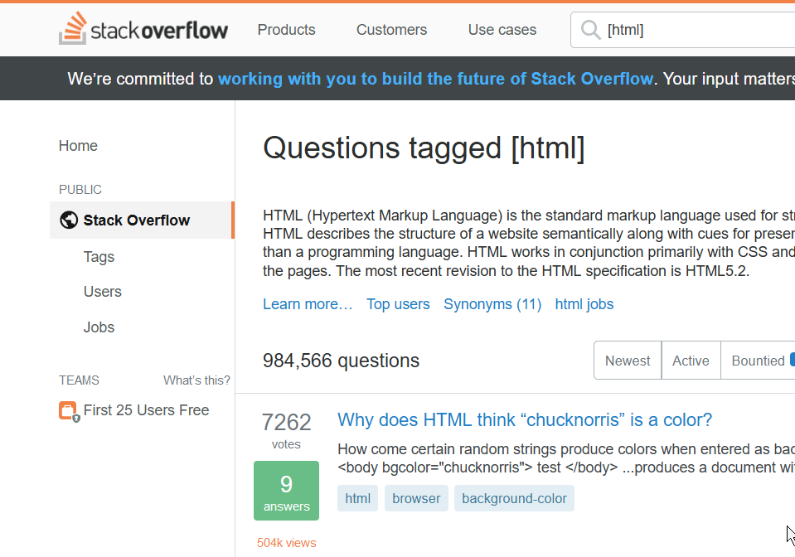
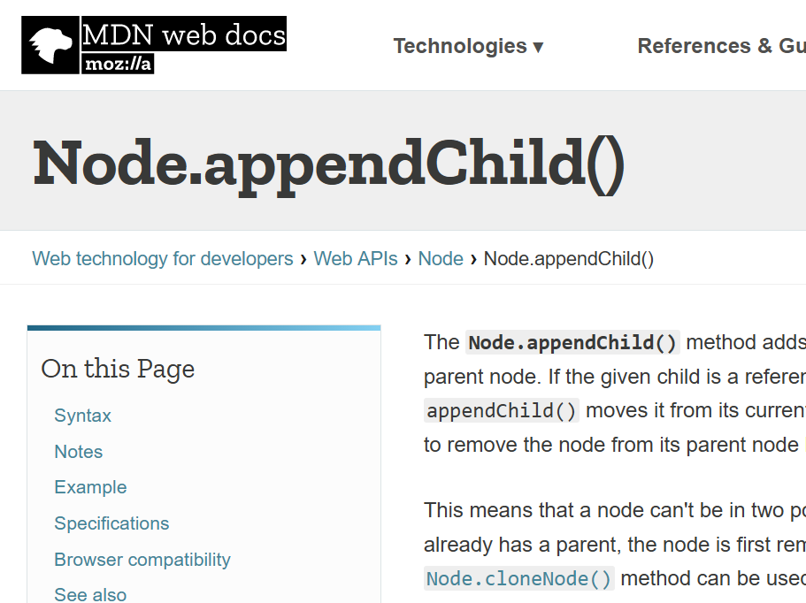



(you, the web developer)

Slide 11
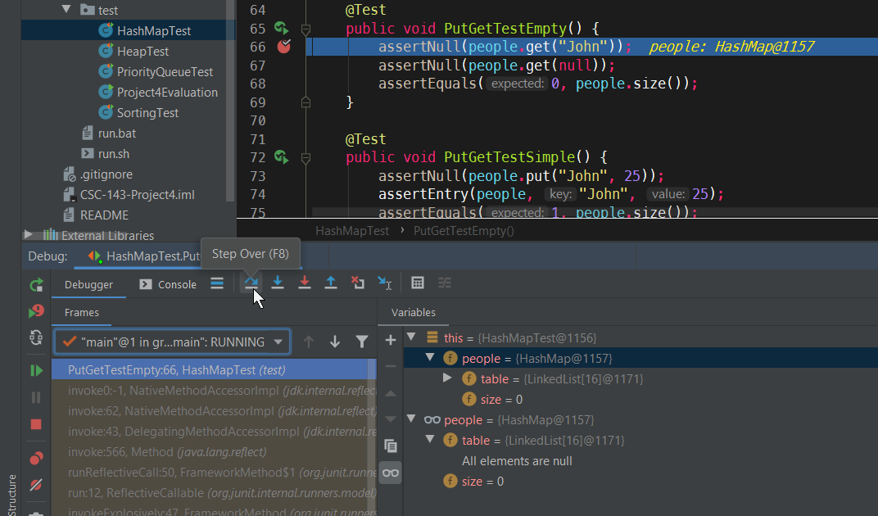

Debugging Websites
HTML
"Hyper-Text Markup Language"
Static text content and descriptive markup
CSS
"Cascading Style Sheets" Static appearance, positioning, styling, animation (new!)
JavaScript
Dynamic content, actual programming, webpage manipulation,
Network requests
Media
Images, video, downloads, files

Slide 12
Debugging Websites
Even if hosted locally, the browser is responsible for execution, not IDE
Problem: website code (HTML/CSS/JS) comes from server, can't pause the server!
GET google.com
200 OK

Slide 13
Debugging Websites
Even if hosted locally, the browser is responsible for execution, not IDE
Let's give the browser a debugger!

Slide 14
DevTools Demo Right Click > Inspect Element [Inspector | Debugger | Network]

Slide 15
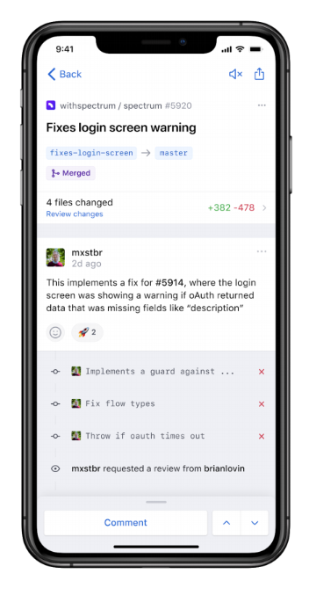
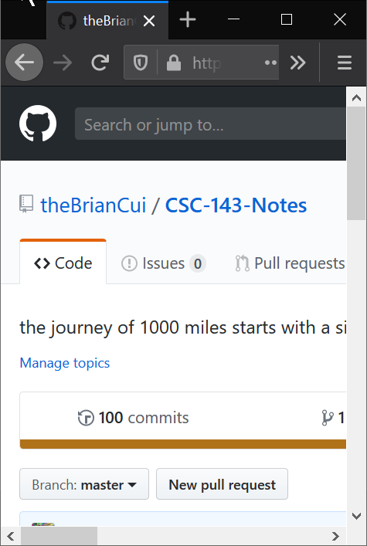
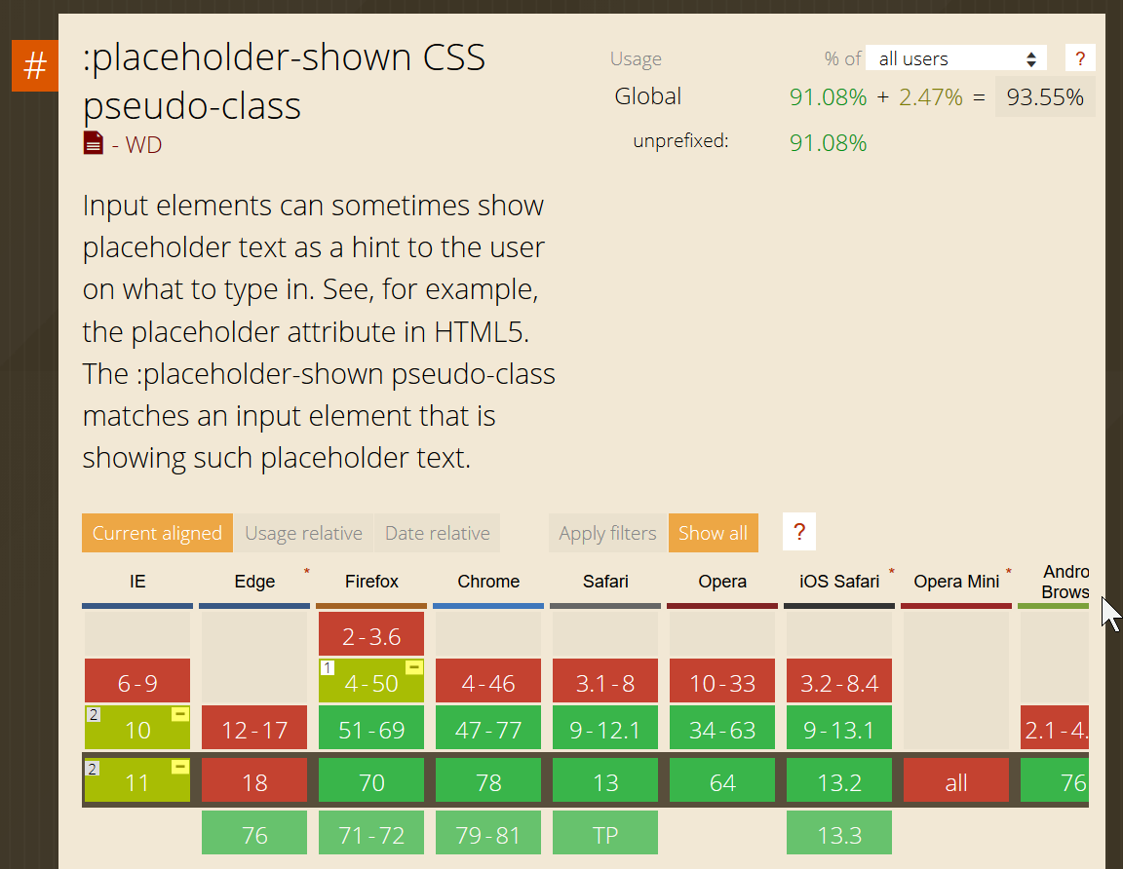
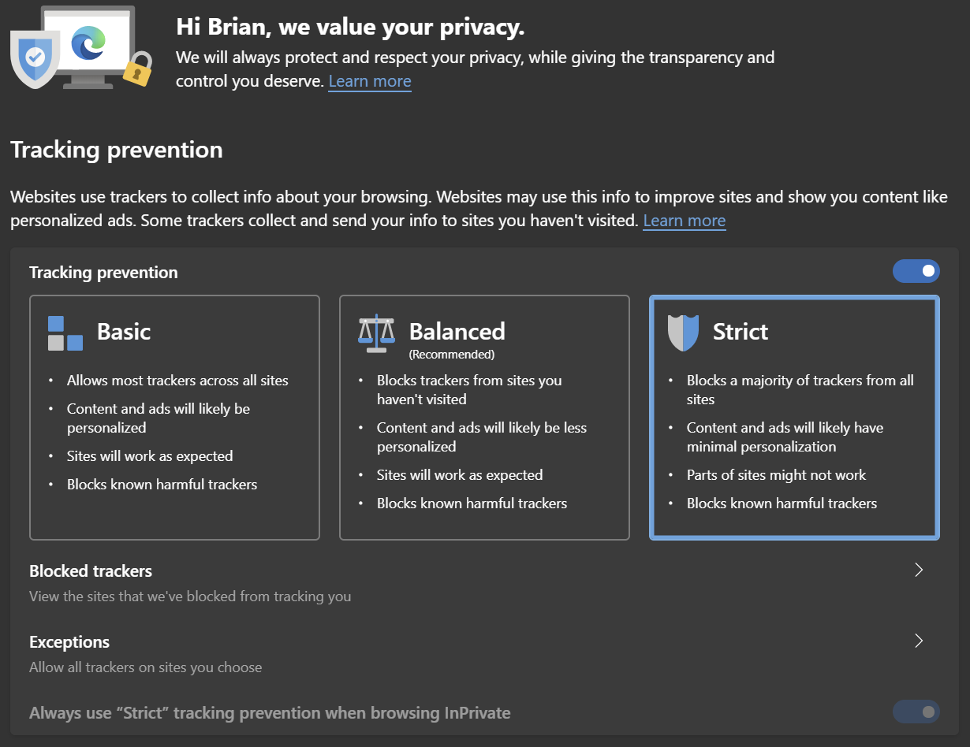

Web Has Come a Long Way (But it's Still Stuck in the Past)
Competing standards
Web App vs. Native
Competing interests
Advertising vs. Privacy
Cross-Browser compatibility
Mobile vs. Desktop
Blink vs. Gecko vs. Webkit
Legacy Enterprise

Slide 16
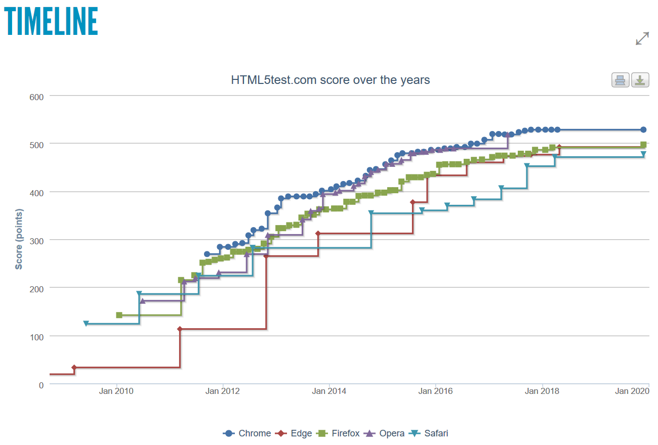

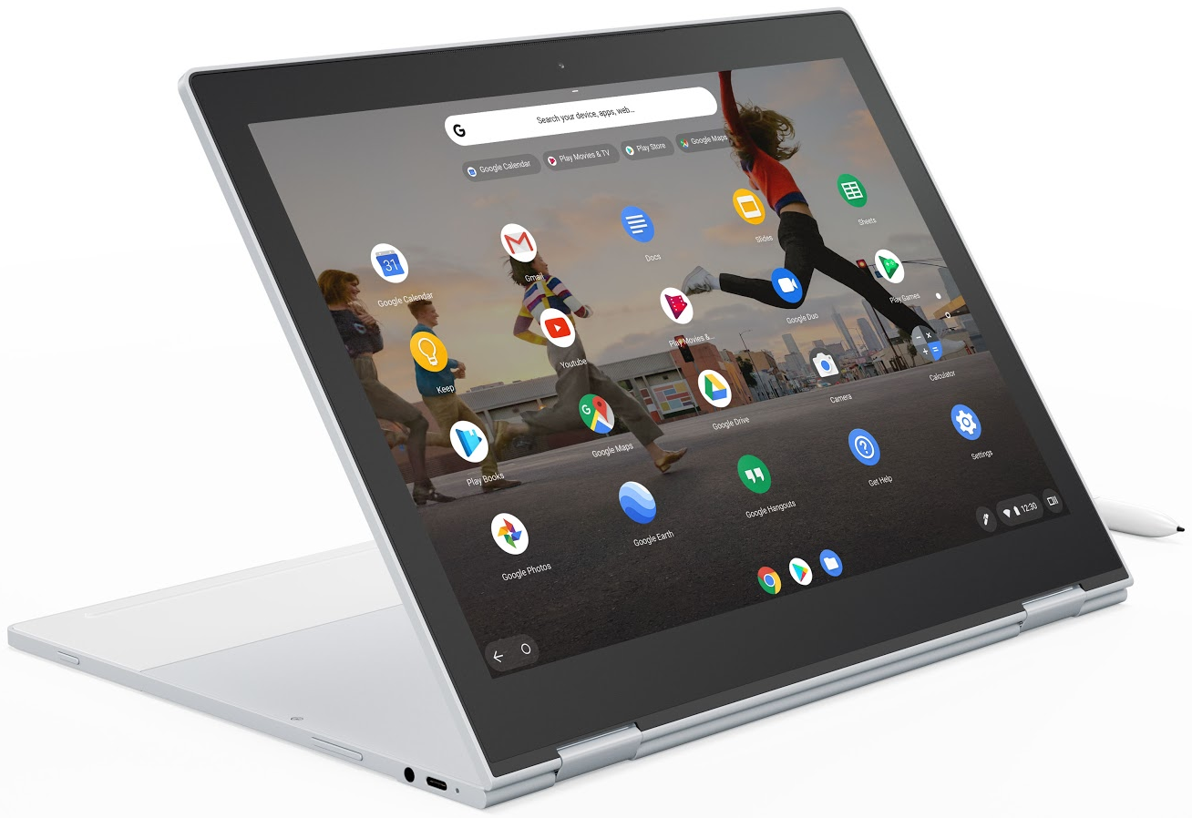

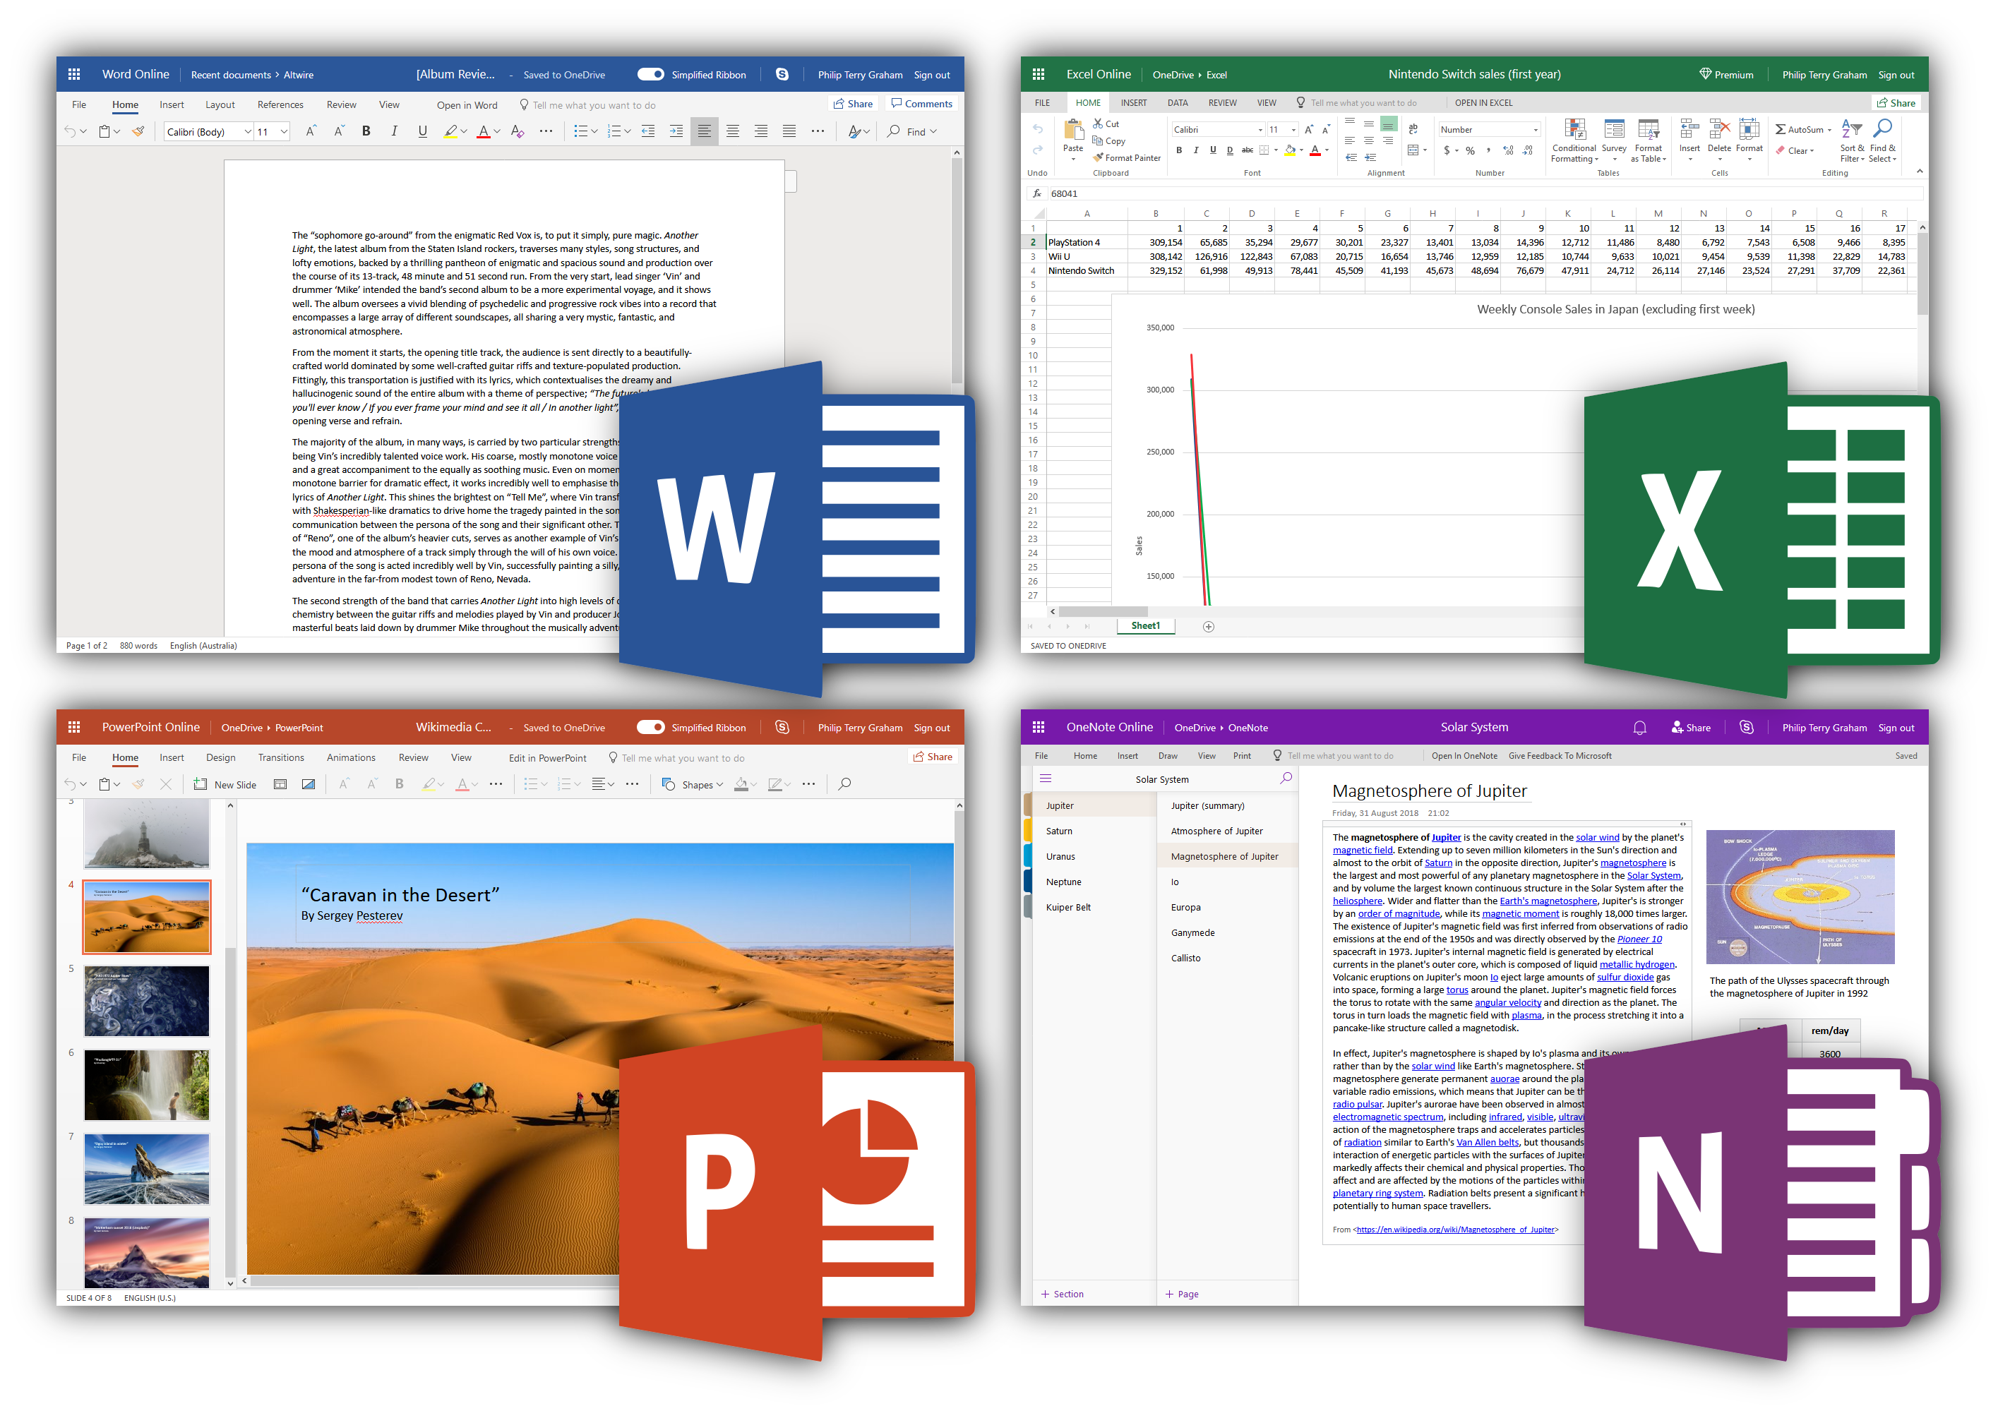

The Future is Now!
Increased Competition → Better Products → ☺

